Slide 1

ONLINE BOOK STORE
Submitted by:
Sahithya
Bhavani
Anu Radha
Sri Latha
Renu Sharma
Under the guidance of:
Pooja Mehta

Slide 2
INTRODUTION
The online Bookstore is a revolution of book industry. The main objective of this project is to design a online bookstore where customer can buy books from online. We develop a code to add books, update new books, insert new book and delete the books in the book store.

Slide 3
TECHNOLOGIES USED
Frontend
Postman
Backend
Spring Boot
Hibernate
MySQL

Slide 4
Functionalities
Entity
Controller
Service
Repository

Slide 5
user HAVE THE FOLLOWING ACCESS
Add New Books
View Books Available
Delete Books
Update Books
Increase Book quantity

Slide 6
ANNOTATIONS USED
@Spring Boot Application
@Rest Controller
@Auto wired
@Path Variable
@Get Mapping
@Post Mapping
@Delete Mapping

Slide 7
These are Annotations used in Entity
@Entity
@Id
@Generated value
@Join column
@Many to one
@One to many

Slide 8
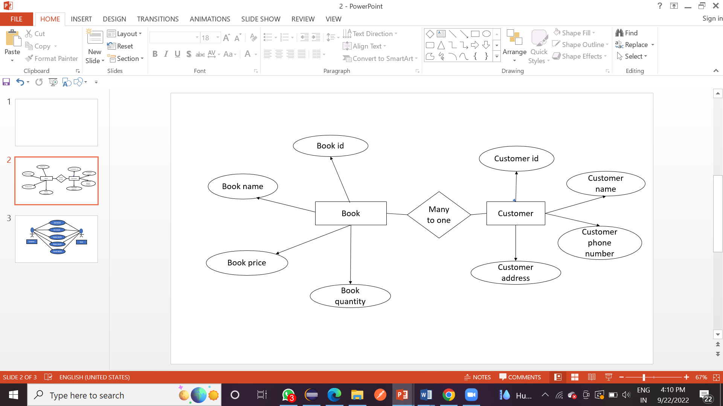
ENTITY DIAGRAM

Slide 9
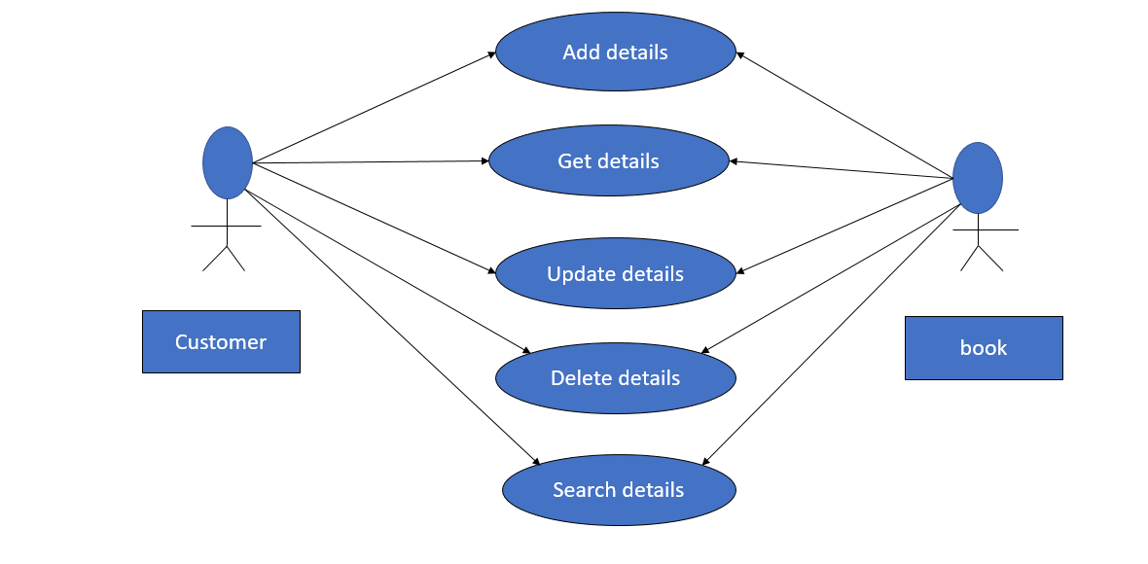
USECASE DIAGRAM

Slide 10
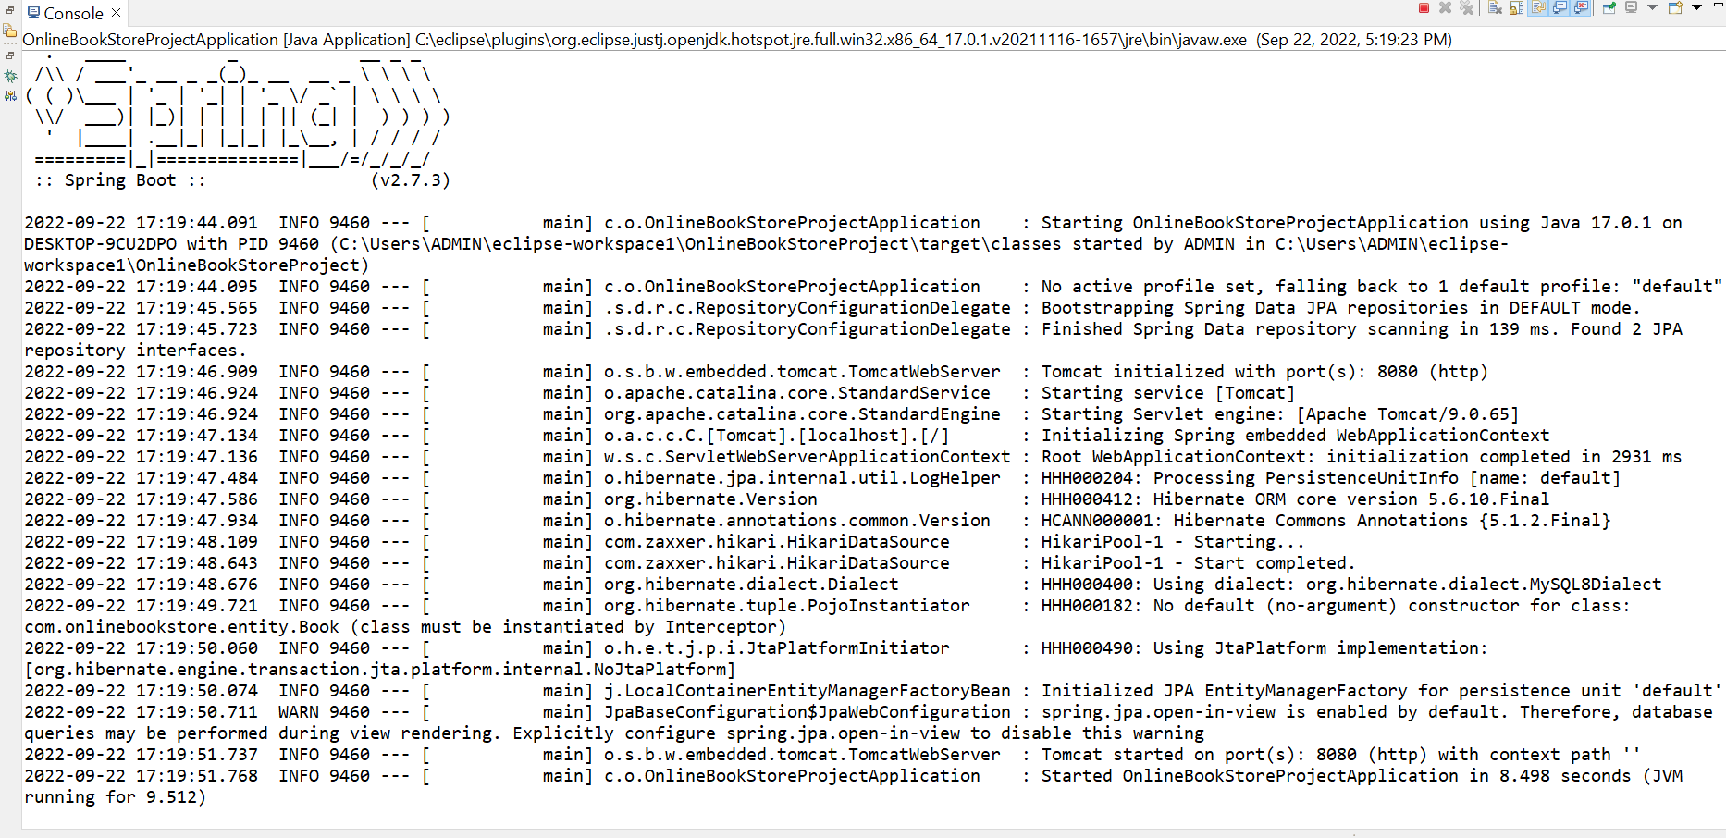
SPRING BOOT APPLICATION OUTPUT

Slide 11
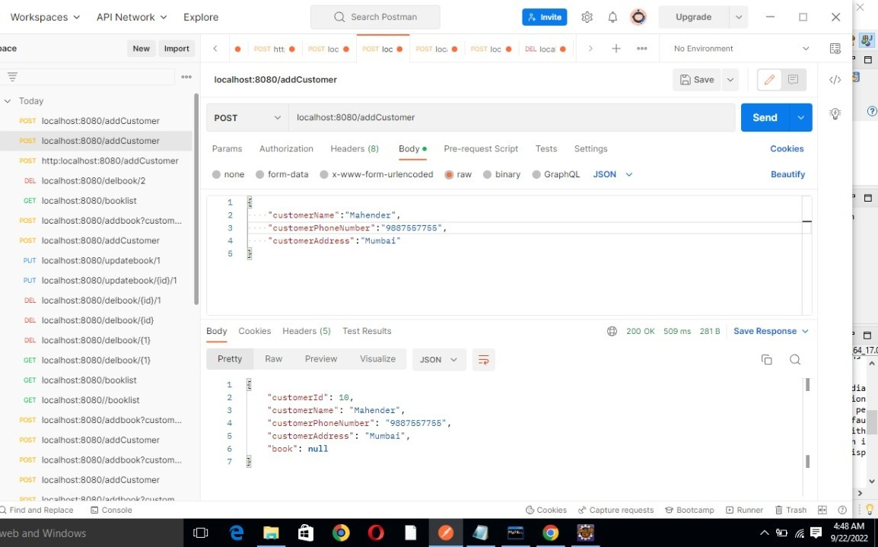
POSTMAN OUTPUT
TO ADD CUSTOMER

Slide 12
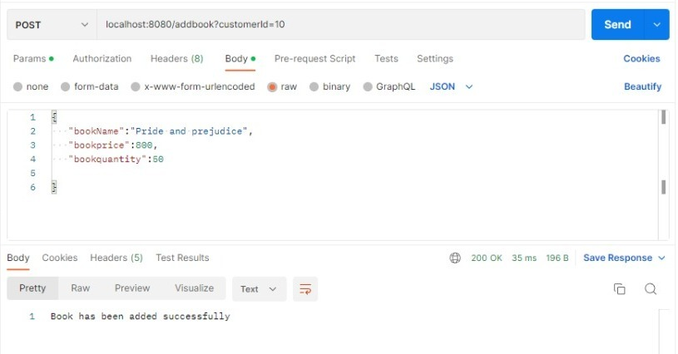
OUTPUT IN POSTMAN - ADD BOOK

Slide 13
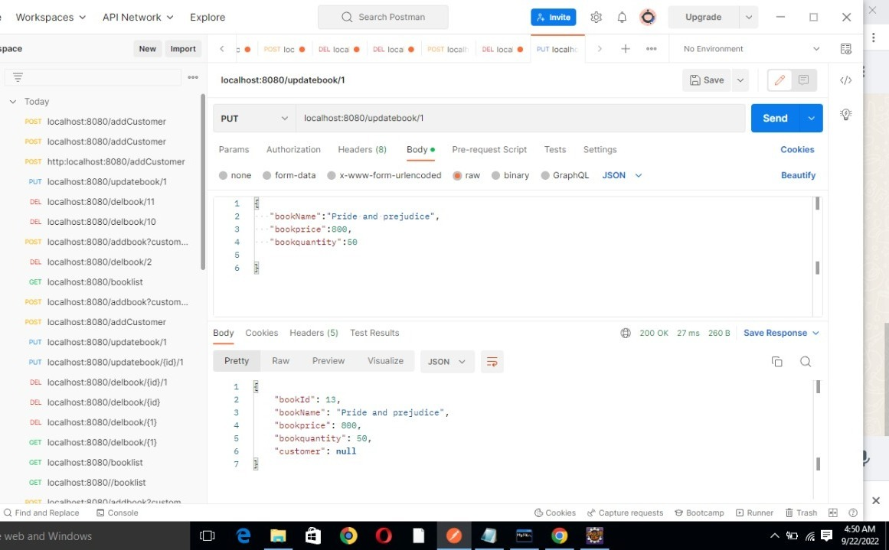
OUTPUT IN POSTMAN - UPDATE BOOK

Slide 14
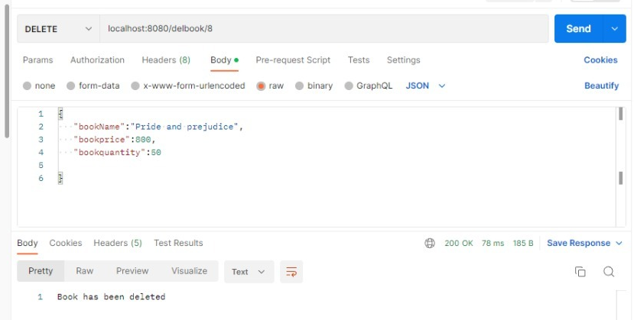
OUTPUT IN POSTMAN - DELETE BOOK

Slide 15
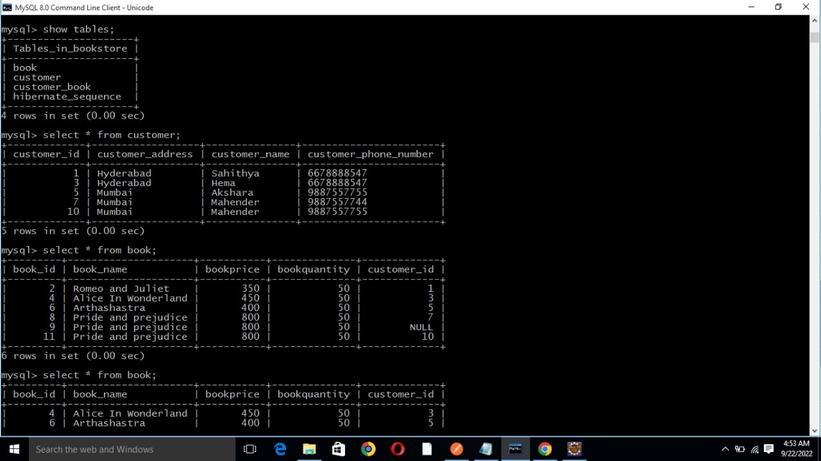
TABELS CREATED IN SQL

Slide 16
FUTURE SCOPE
In future we can create a web page where customer can shop online
Login
Register
Payment

